Slide 1
CS 170 Segment 6 Machine Learning
Notes based from Dr. Eamonn Keogh

Slide 2
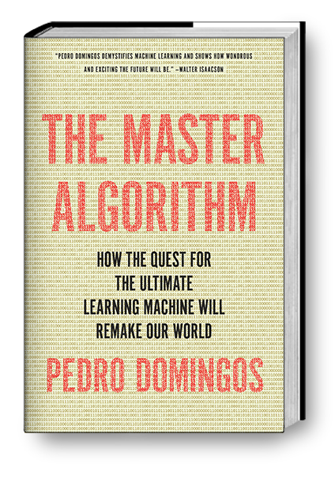
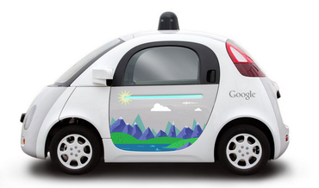
Machine Learning
Machine learning explores the study and construction of algorithms that can learn from data
Basic Idea: Instead of trying to create a very complex program to do X. Use a (relatively) simple program that can learn to do X.
Example: Instead of trying to program a car to drive
(if light(red) && NOT(pedestrian) || speed(x) <= 12 && …)
Create a program that watches human drive,
and learns how to drive*

Slide 3
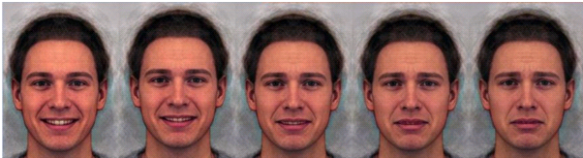
Why Machine Learning I
Why do machine learning instead of just writing an explicit program?
It is often much cheaper, faster and more accurate.
It may be possible to teach a computer something that we are not sure how to program. For example:
We could explicitly write a program to tell if a person is obese
If (weight_{kg} / (height_m x height_m)) > 30, printf(“Obese”)
We would find it hard to write a program to tell if a person is sad. However, we could easily obtain a 1000 photographs of sad people/not sad people, and ask a machine learning algorithm to learn to tell them apart

Slide 4
Why Machine Learning II
Sometimes we need to relearn things at a speed that a human could not keep up with, if she had to keep rewriting code
Imagine you wrote a spam classifier
If observed(‘Nigeria’, ‘$$$$’) || IP == 1.60.10.240 || ….
The moment you deployed this algorithm, the hackers could defeat
The could misspell keywords N1geria, Nig@ria
They could change their IP
Etc
What is needed here is an algorithm that relearns what spam is, every minute of the day, forever

Slide 5
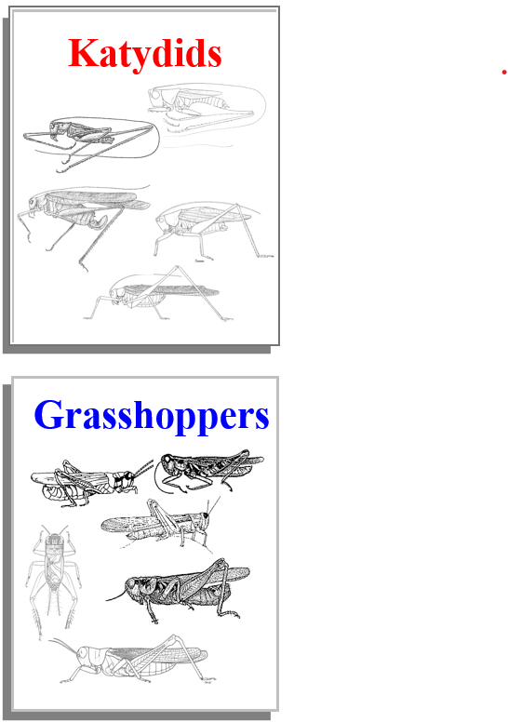
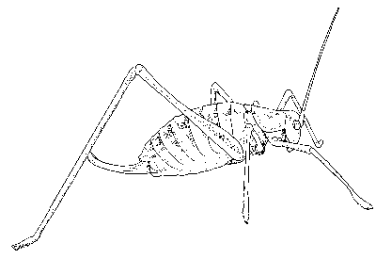
The Classification Problem (Informal definition)
Given a collection of annotated data.
In this case 5 instances of Katydids and
Five of Grasshoppers, decide what type of
insect the unlabeled example is
Katydid or Grasshopper?

Slide 6
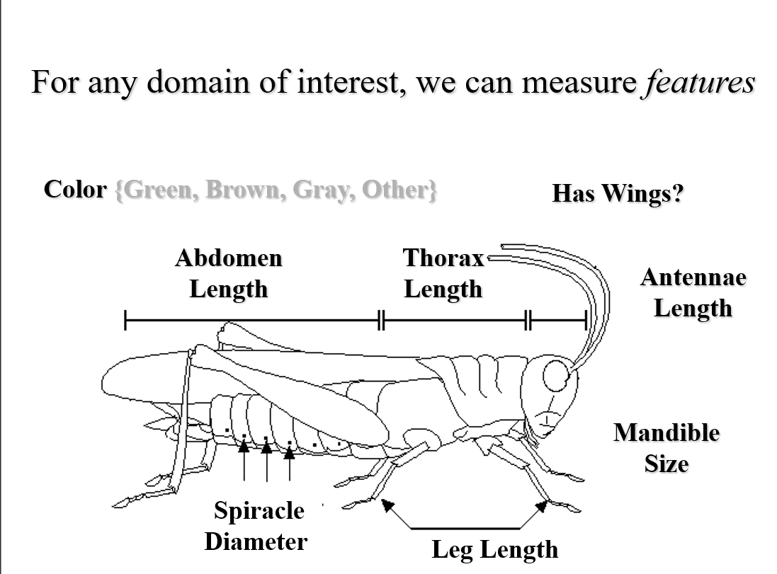

Slide 7
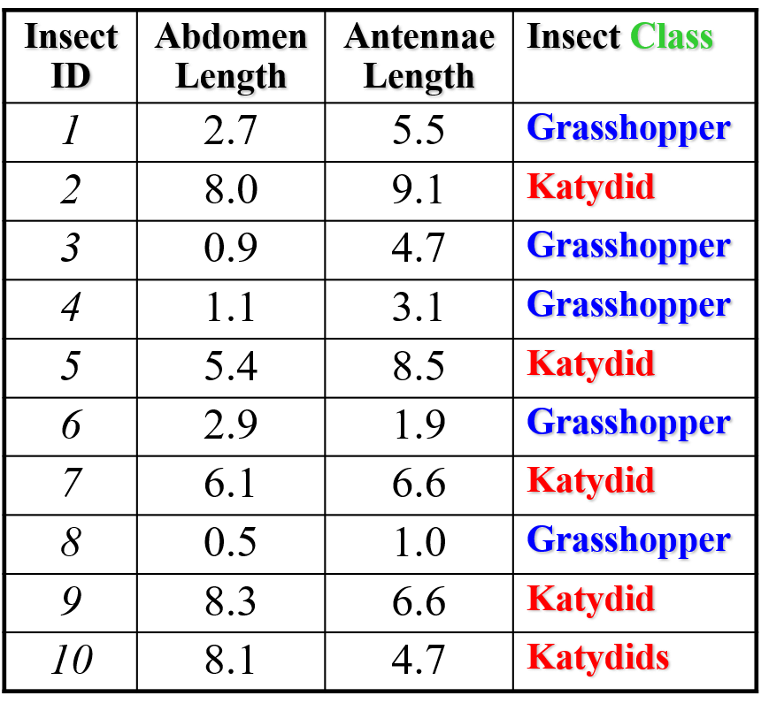
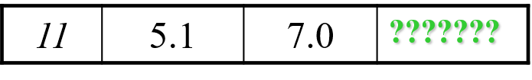
My_Collection
We can store features in a database
The classification problem can
now be expressed as:
Given a training database (My_Collection), predict
the class label of Previously
unseen instance
previously unseen instance =

Slide 8
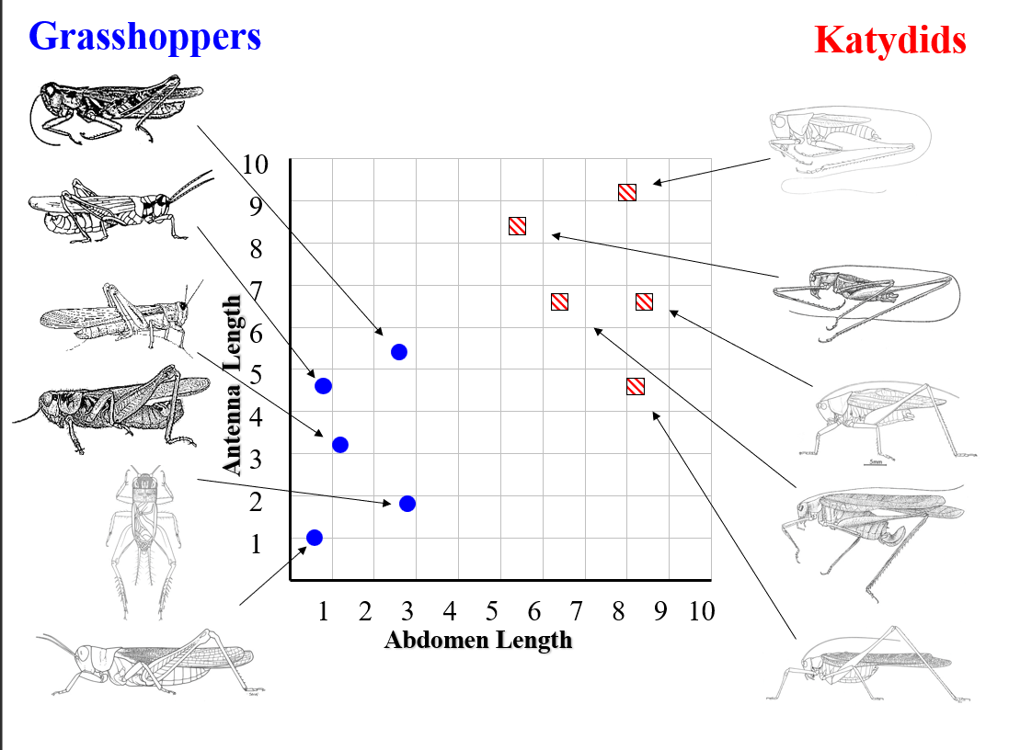

Slide 9
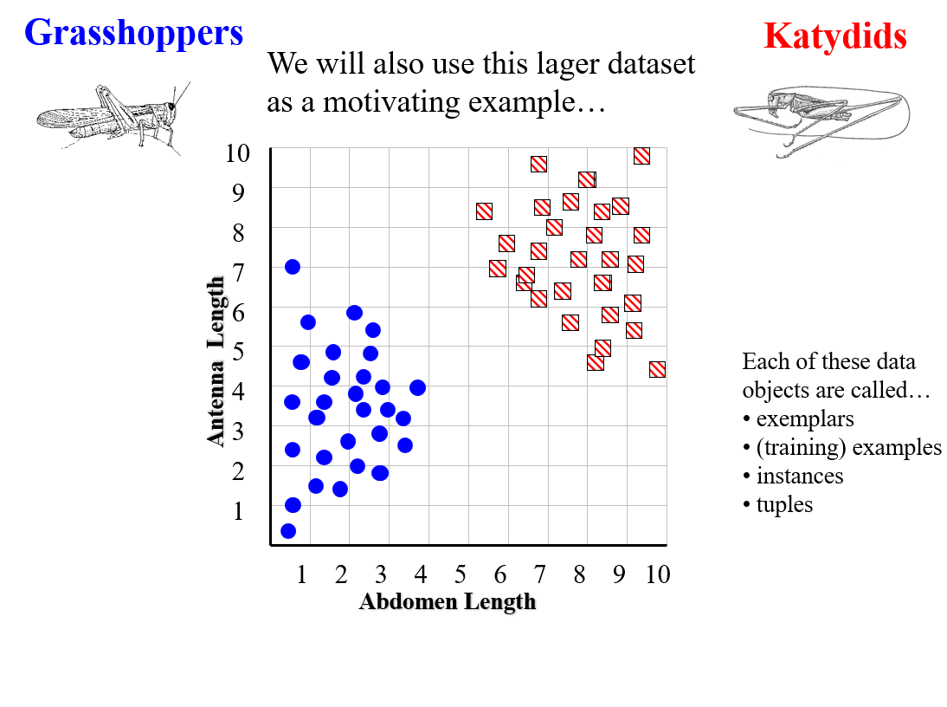

Slide 10
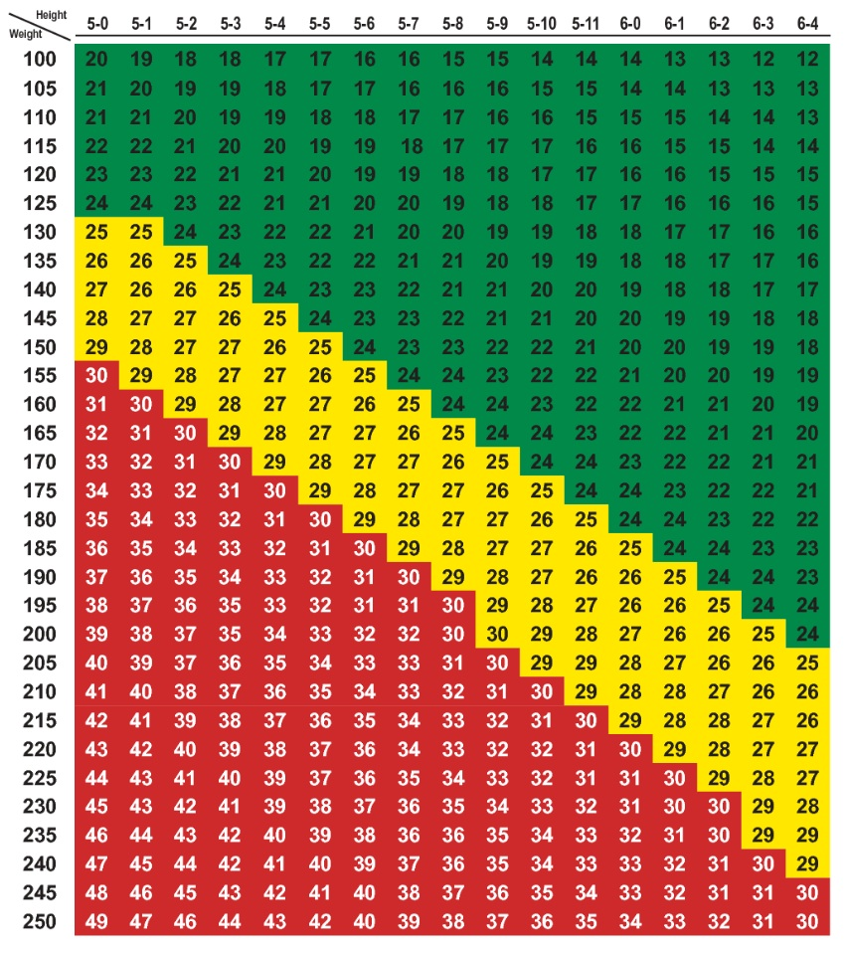

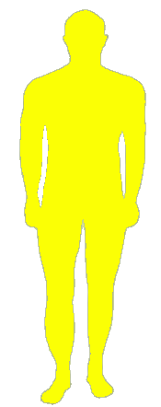

Smoothness Assumption
A basic assumption that all machine
Learning algorithms make is that if two
points in space are close to each other,
They probability share the same
Class label
Underweight
Normal Weight
Overweight

Slide 11
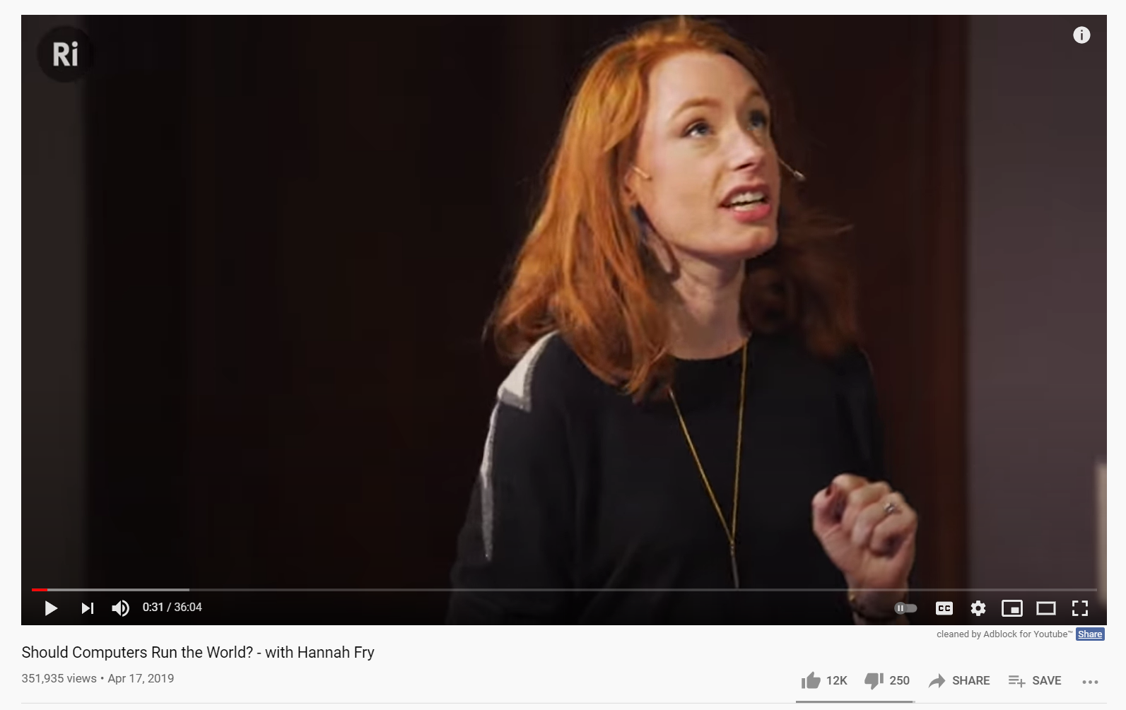
Assignment, watch the first three minutes of this video
Should Computers Run the World? – with Hannah Fry
https://www.youtube.com/watch?v=Rzhpf1Ai7Z4&

Slide 12
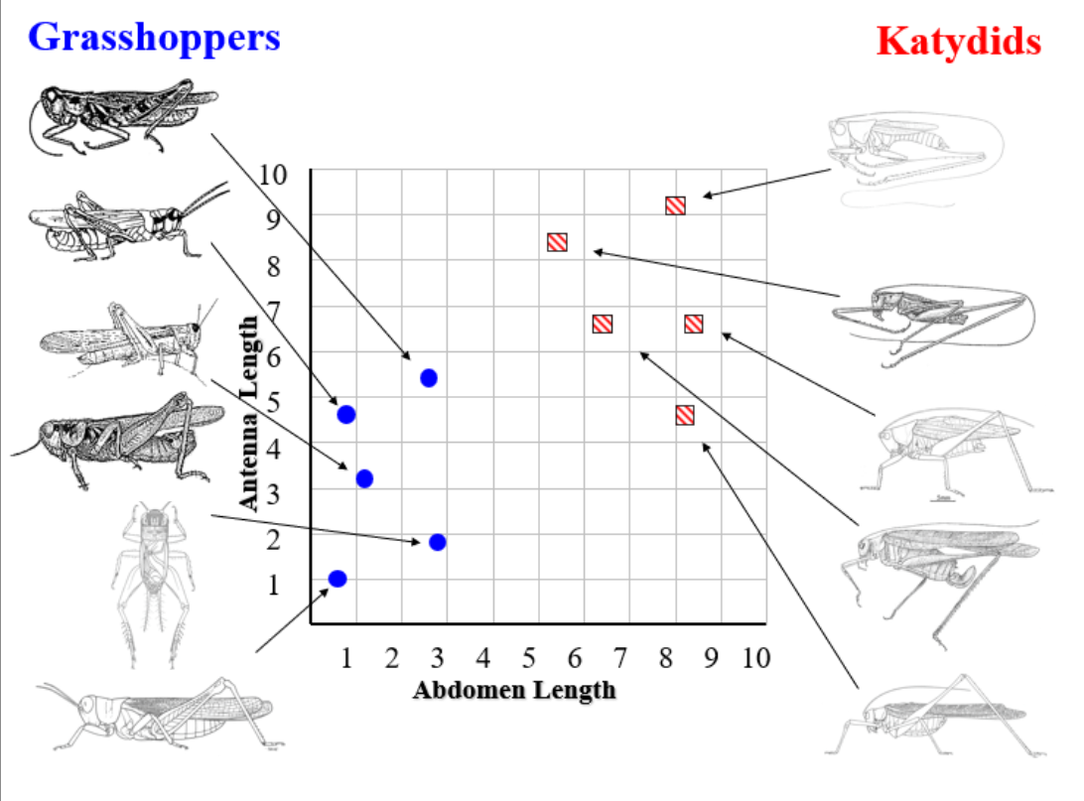

Slide 13
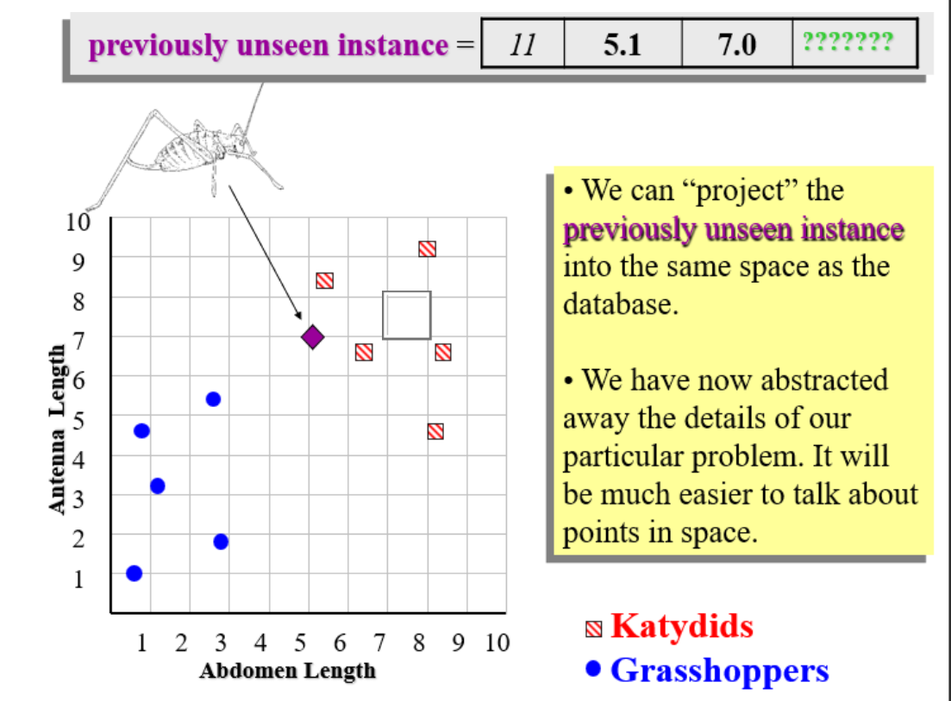

Slide 14
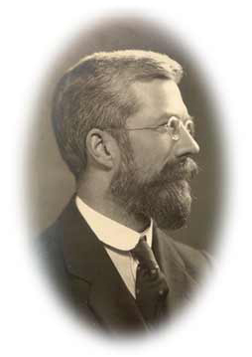
Simple Linear Classifier
10
9
8
7
R.A. Fisher
1890-1962
6
5
If previously unseen instance above the line
then
class is Katydid
else
class is Grasshopper
4
3
2
1
Katydids
Grasshoppers
1
2
3
4
5
6
7
8
9
10

Slide 15
Simple Linear Classifier
Where did the line come from?
Lets just get a visual intuition
We can connect every point to a line…
I just connected a few lines here for visual clarity
10
9
8
7
6
5
4
3
2
1
1
2
3
4
5
6
7
8
9
10

Slide 16
Simple Linear Classifier
10
We can connect every point to a line…
We can use those lines to create squares…
9
8
7
6
5
4
3
2
1
1
2
3
4
5
6
7
8
9
10

Slide 17
Simple Linear Classifier
10
9
If we move the line, the squares will change
Some will get larger, some will get smaller
8
7
6
5
4
3
2
1
1
2
3
4
5
6
7
8
9
10

Slide 18
Simple Linear Classifier
10
9
If we move the line, the squares will change
Some will get larger, some will get smaller
The line we want is the one that has the minimum area of all the squares, the sum of squares algorithm
8
7
6
5
4
3
2
1
1
2
3
4
5
6
7
8
9
10

Slide 19
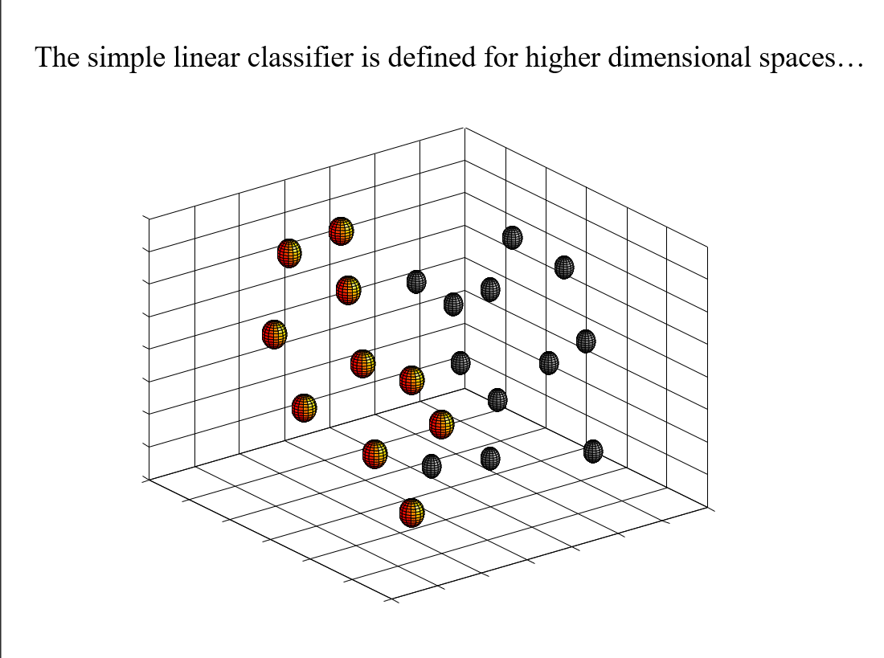

Slide 20
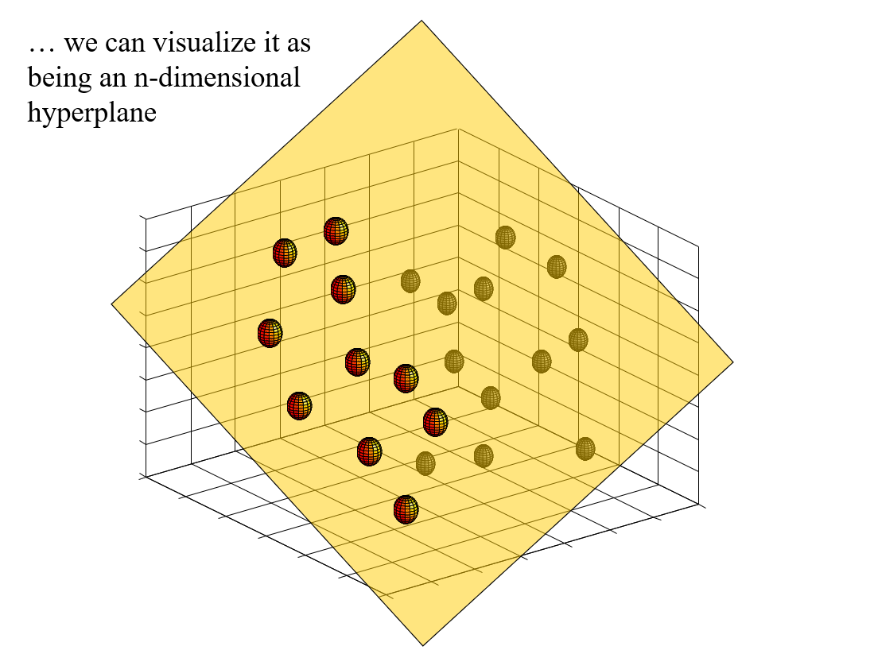

Slide 21
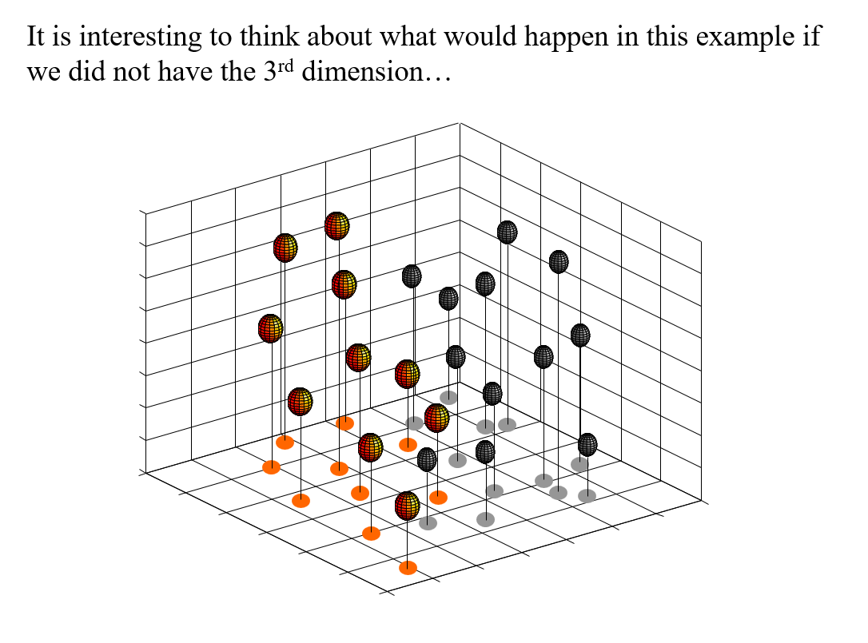

Slide 22
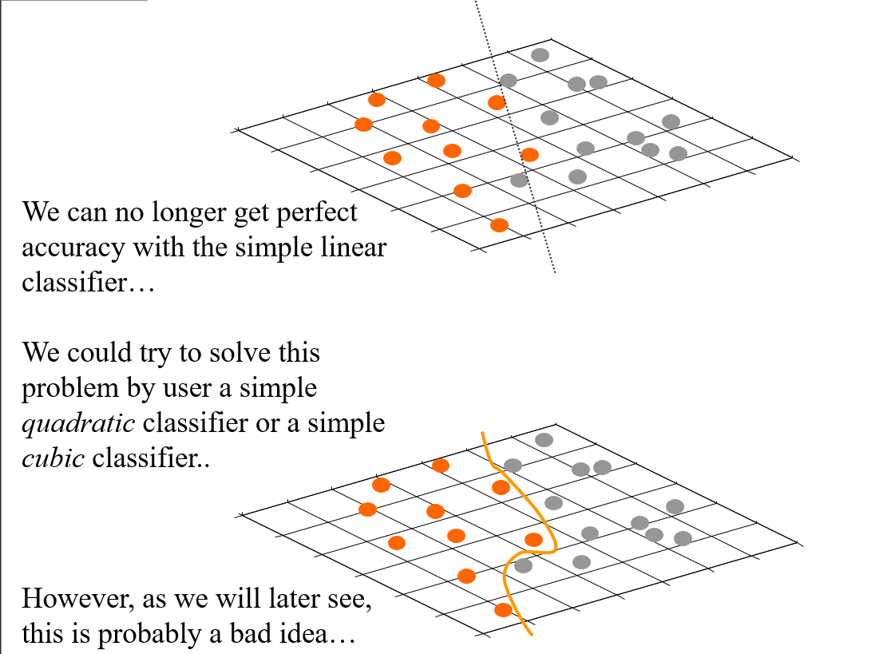

Slide 23
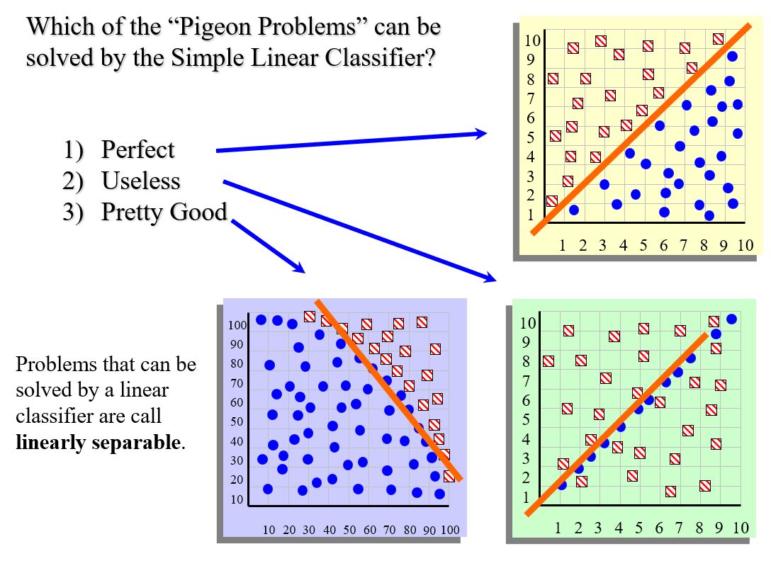

Slide 24
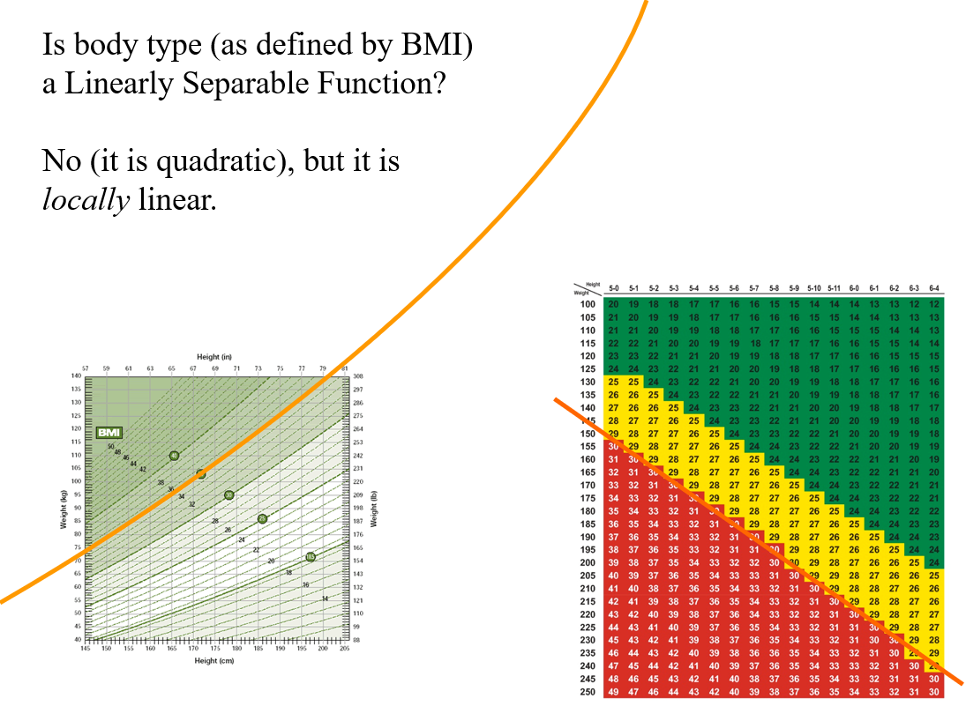

Slide 25
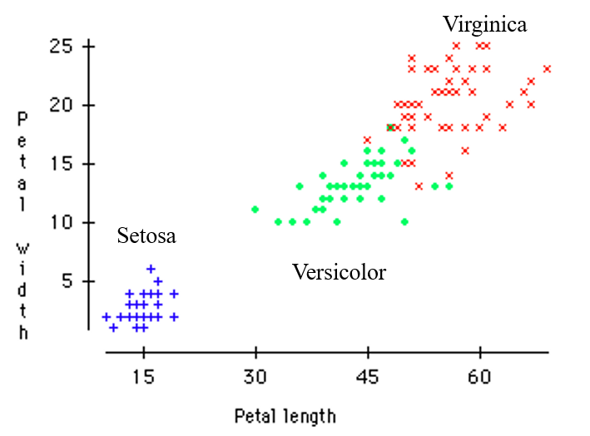
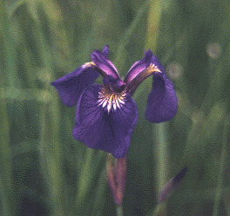
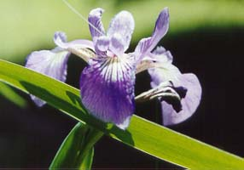
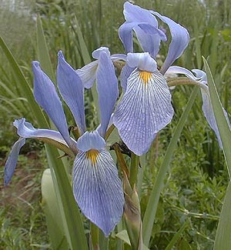
A Famous Problem
R. A. Fisher’s Iris Dataset
3 classes
50 of each class
The task is to classify Iris plants into one of 3 varieties using the Petal Length and Petal Width
Iris Setosa
Iris Versicolor
Iris Virginica

Slide 26
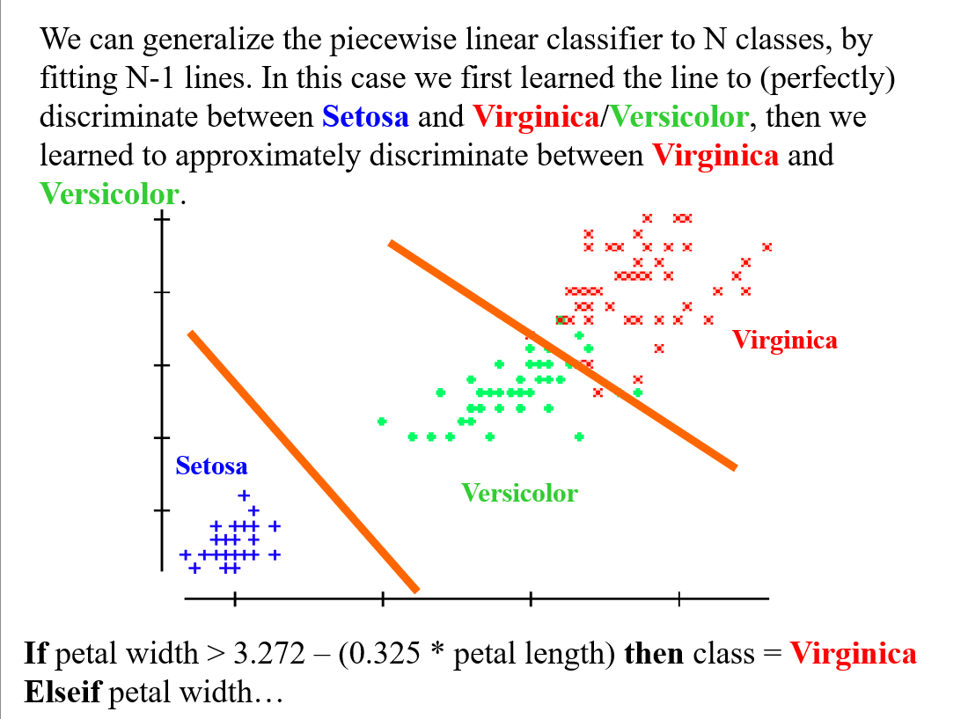

Slide 27
We have now seen one classification algorithm, and we are about to see more. How should we compare them?
Predictive accuracy
Speed and scalability
-time to construct the model
-time to use the model
Robustness
-handling noise, missing values and irrelevant features, streaming data
Interpretability
-understanding and insight provided by the model

Slide 28
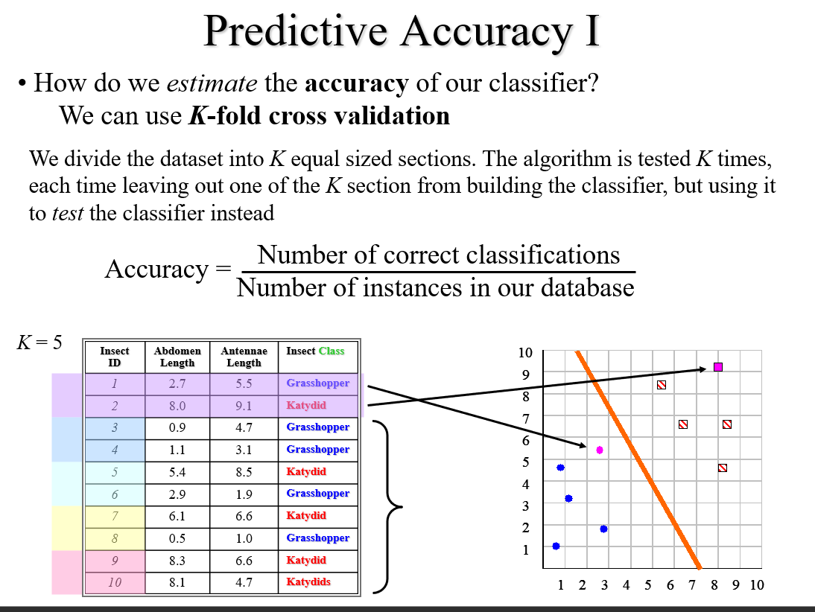

Slide 29
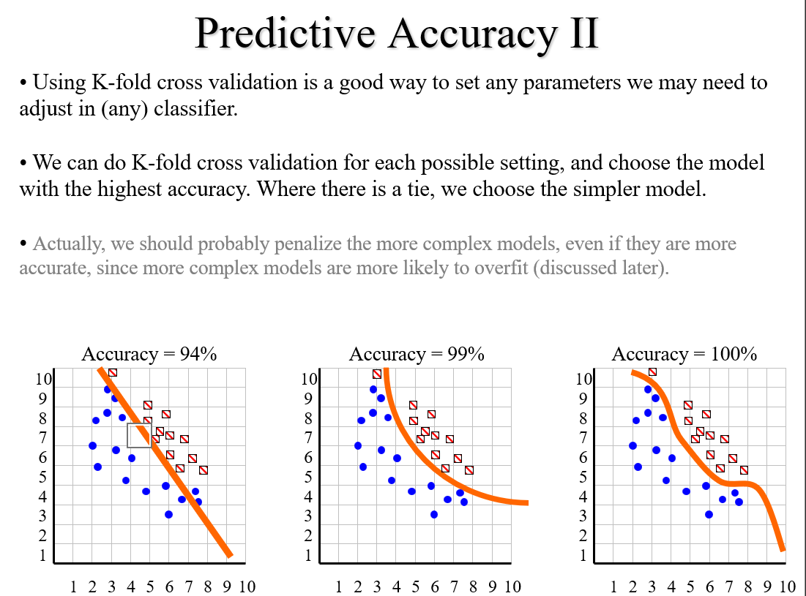

Slide 30
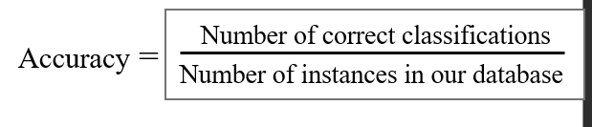
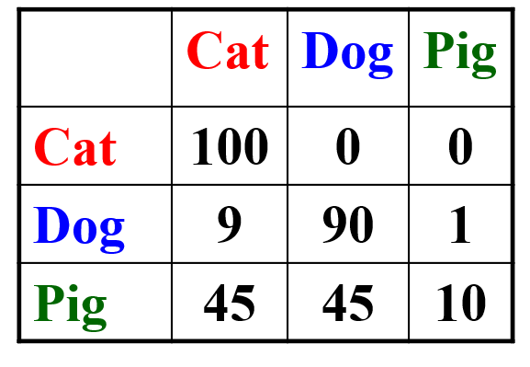
Predictive Accuracy III
Accuracy is a single number, we may be better off looking at a confusion matrix. This gives us additional useful information
True label is...
Classified as a…

Slide 31
Speed and Scalability I
We need to consider the time and space requirements for the two distinct phases of classification:
Time to construct the classifier
In the case of the simple linear classifier, the time taken to fit the line, this is linear in the number of instances O(n)
Time to use the model
In the case of the simpler linear classifier, the time taken to
Test which side of the line the unlabeled instance is. This
Can be done in constant time O(1)
As we shall see, some classification algorithms are very efficient in one aspect, and very poor in the other.

Slide 32
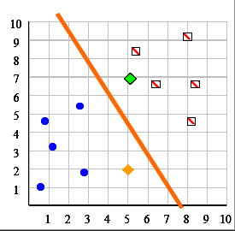
Robustness I
We need to consider what happens when we have:
Noise
For example, a persons age could have been mistyped as 650 instead of 65, how does this effect our classifer? (This is important only for building the classifier, if the instance to be classified is noisy we can do nothing).
Missing values
For example, suppose we want to classify an insect, but we only know the abdomen length (X-axis), and not the antennae length (Y-axis). So we have (5,?).
Can we still classify the instance?
It might be say (5,7) then in the red class
It might be say (5,2) then in the blue class

Slide 33
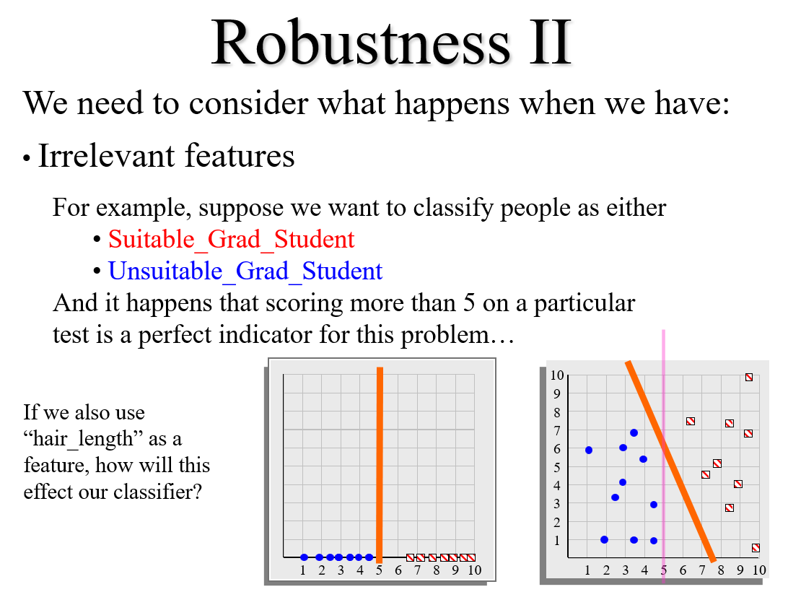

Slide 34
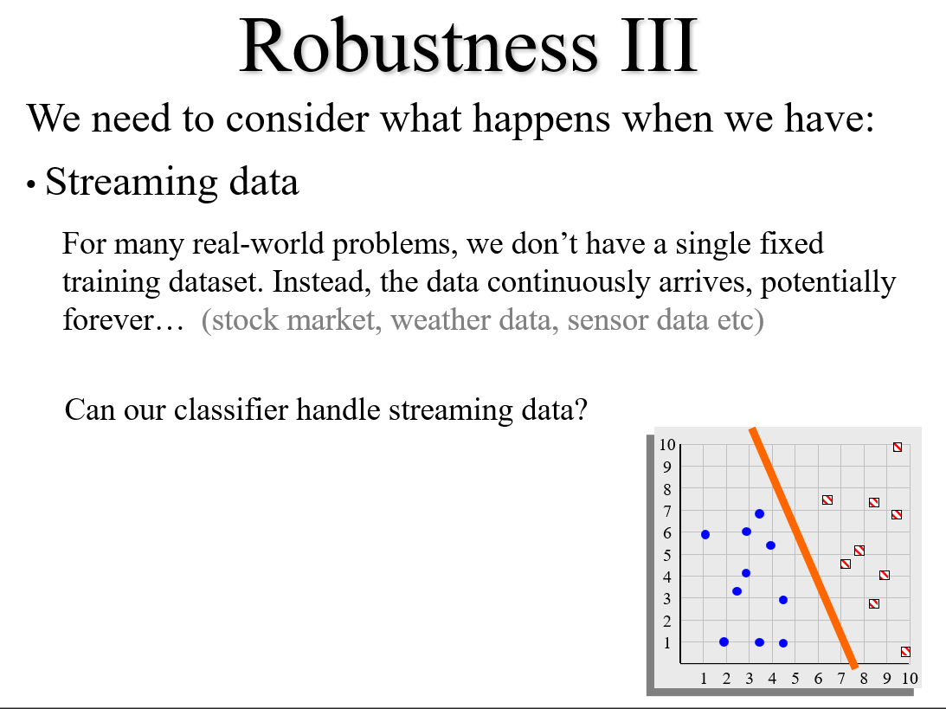

Slide 35
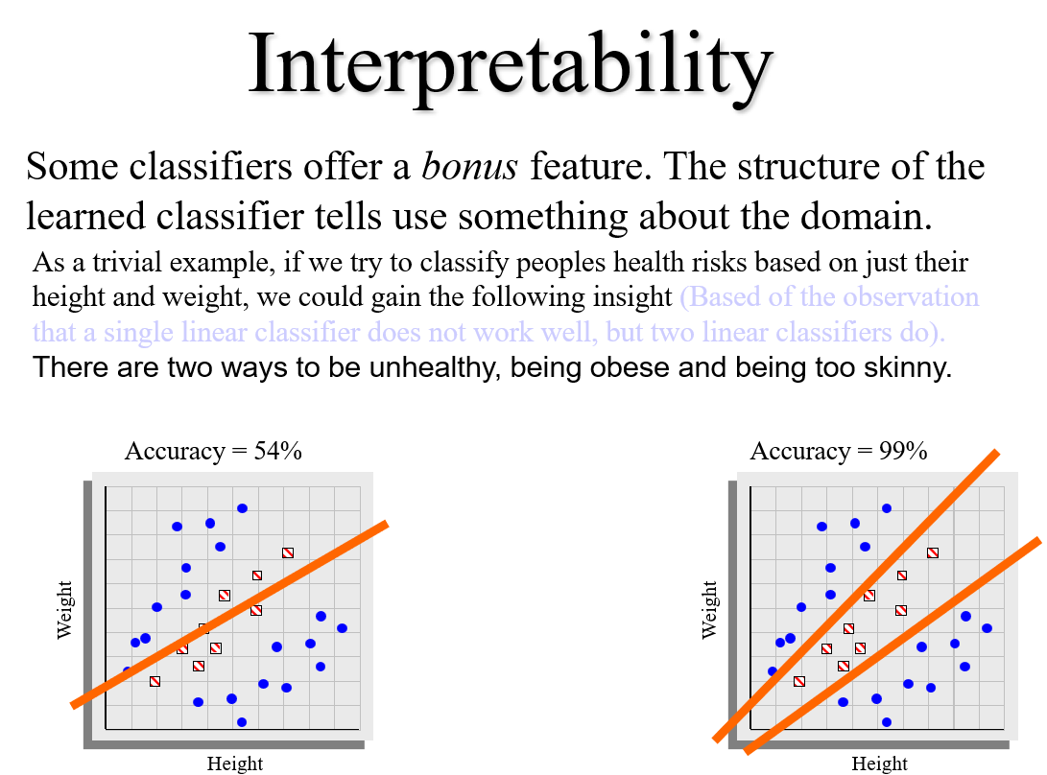

Slide 36
Recap: We have now seen one classification algorithm, and we are about to see more. How should we compare them?
Predictive accuracy
Speed and scalability
-time to construct the model
-time to use the model
Robustness
-handling noise, missing values and irrelevant features, streaming data
Interpretability
-understanding and insight provided by the model

Slide 37
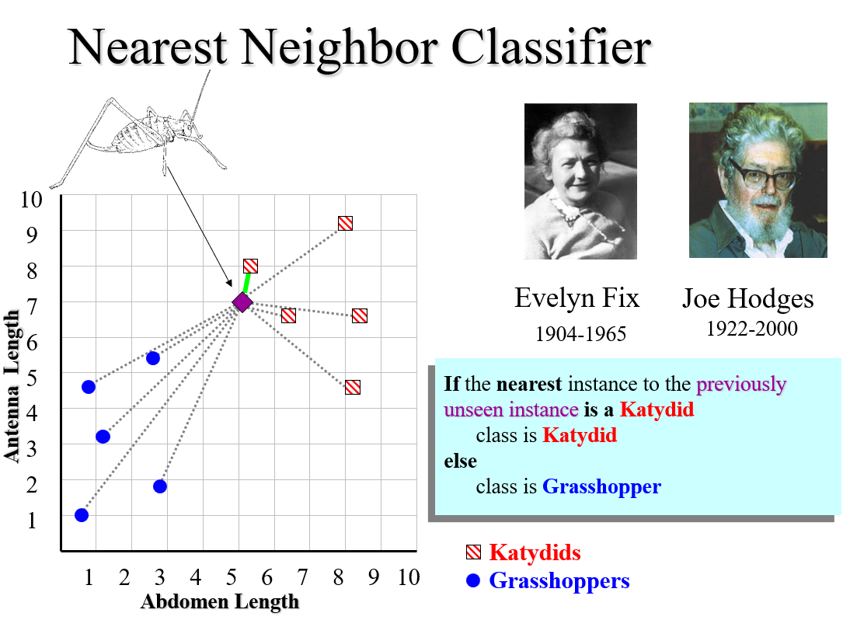

Slide 38
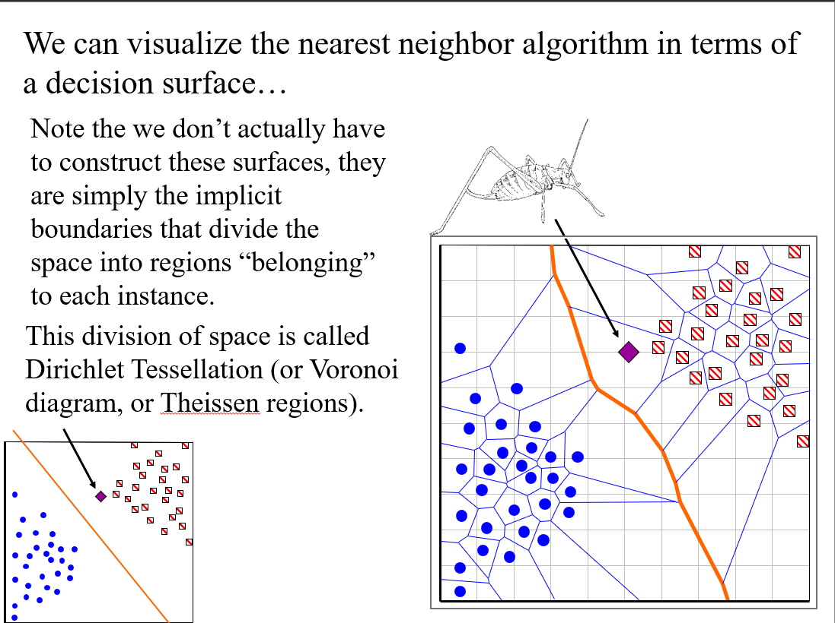

Slide 39
The nearest neighbor algorithm is sensitive to outliers
The solution is to

Slide 40
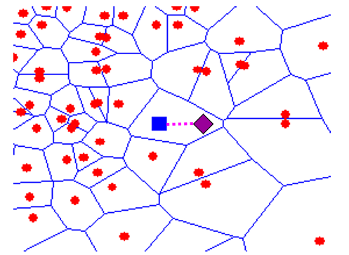
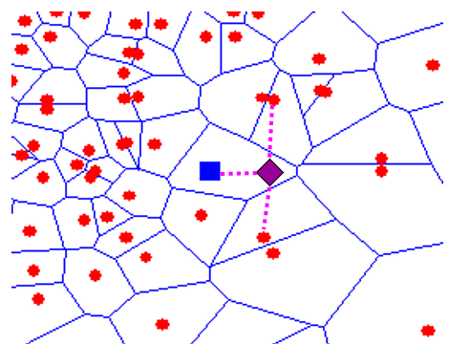
We can generalize the nearest neighbor algorithm to the K-nearest neighbor (KNN) algorithm
We measure the distance to the nearest K instances, and let them vote. K is typically chosen to be an odd number
K = 1
K = 3

Slide 41
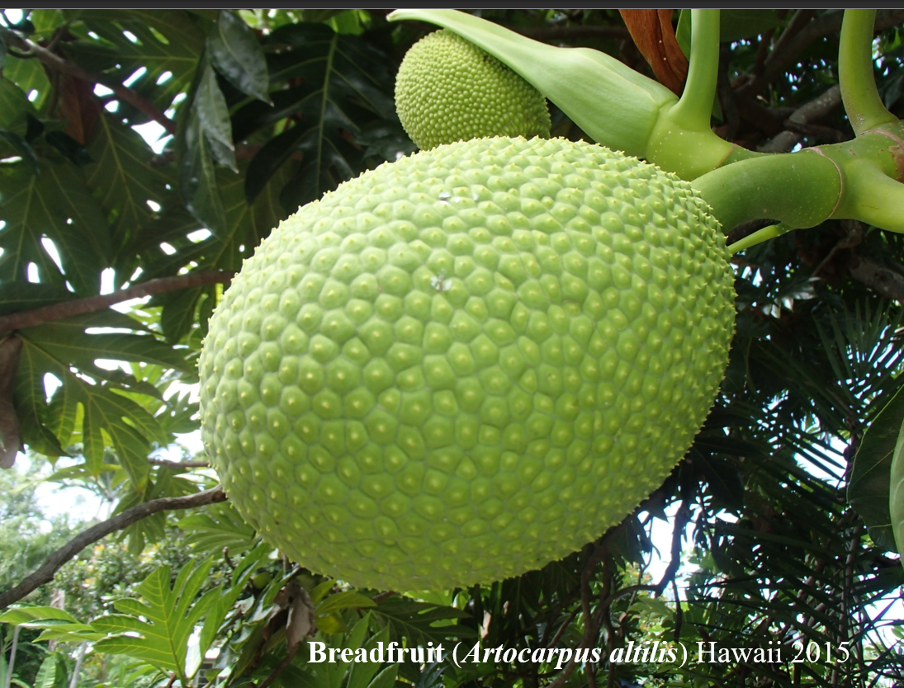

Slide 42
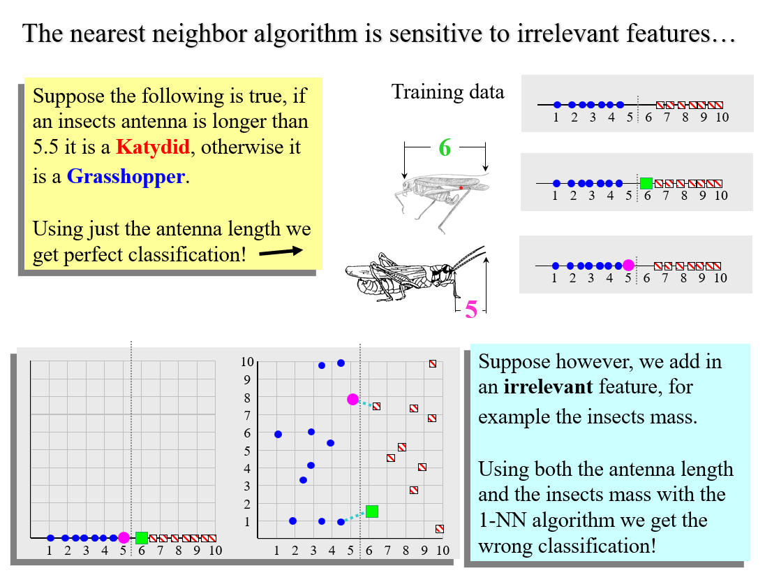

Slide 43
How do we mitigate the nearest neighbor algorithms sensitivity to irrelevant features?
Use more training instances
Ask an expert what features are relevant to the task
Use statistical tests to try to determine which features are useful
Search over feature subsets (in the next slide we will see why this is hard)

Slide 44
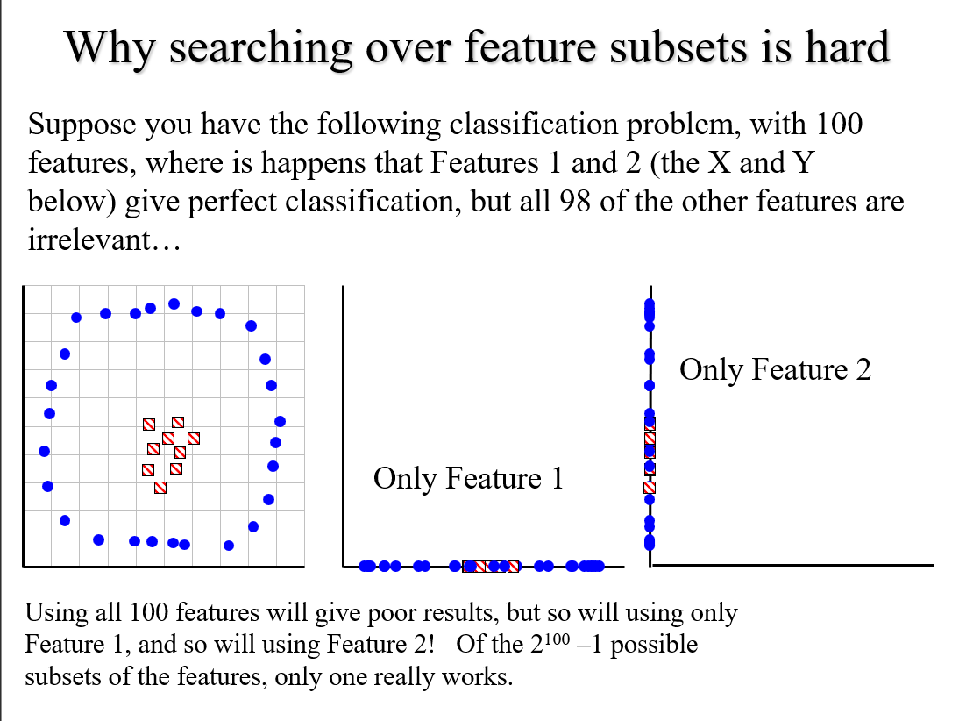

Slide 45
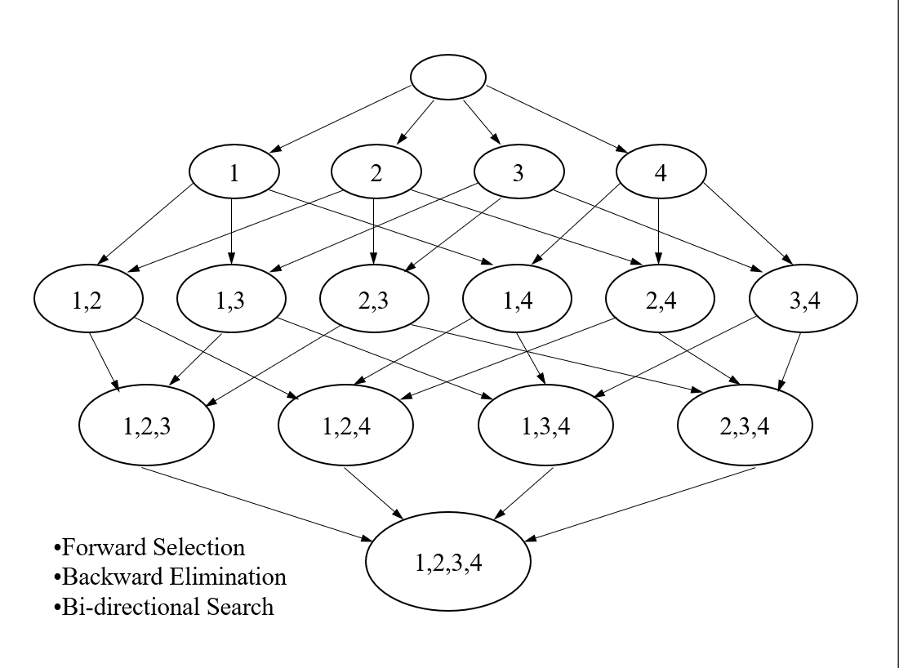

Slide 46
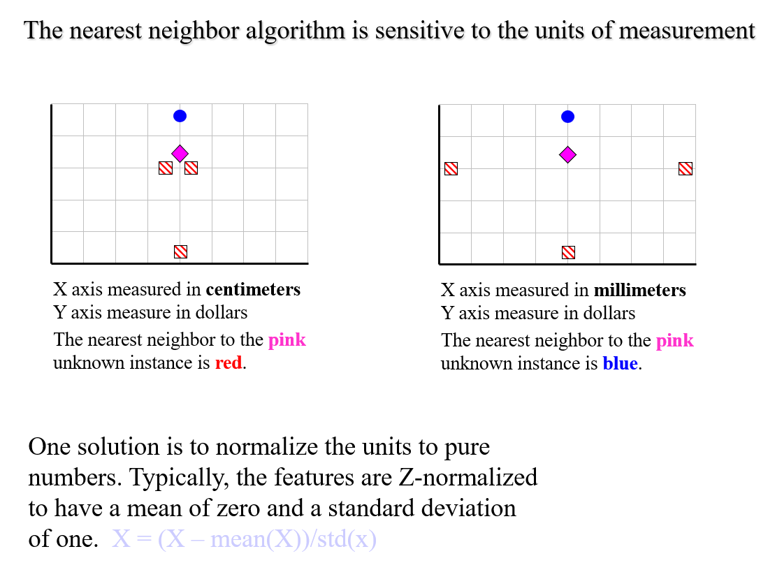

Slide 47
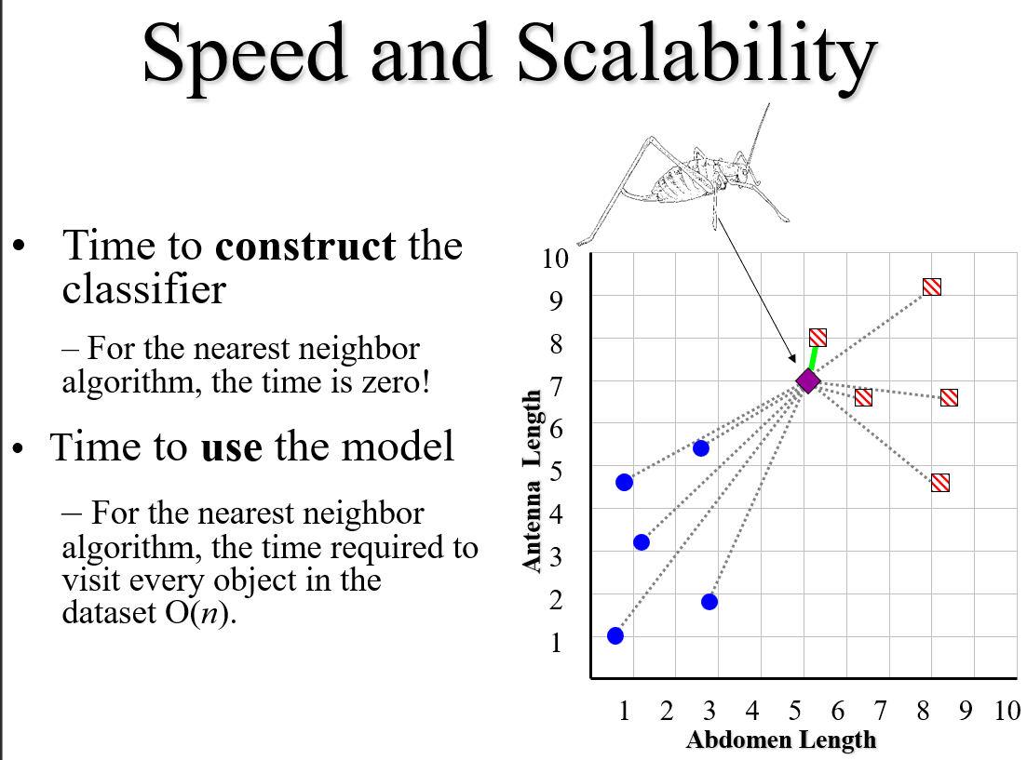

Slide 48
We can speed up nearest neighbor algorithm by “throwing away” some data. This is called data editing.
Note that this can sometimes improve accuracy
We can also speed up classification with indexing
One possible approach. Delete all instances that are surrounded by members of their own class.

Slide 49
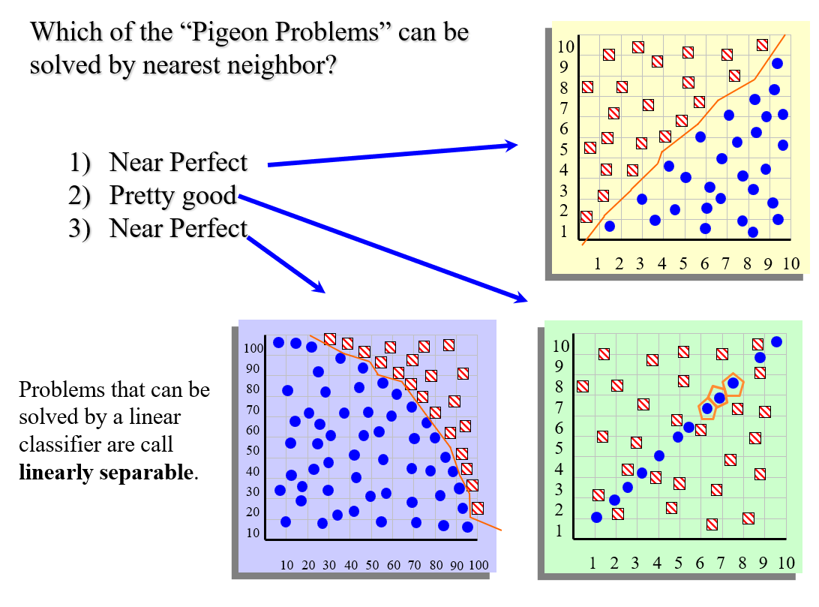

Slide 50
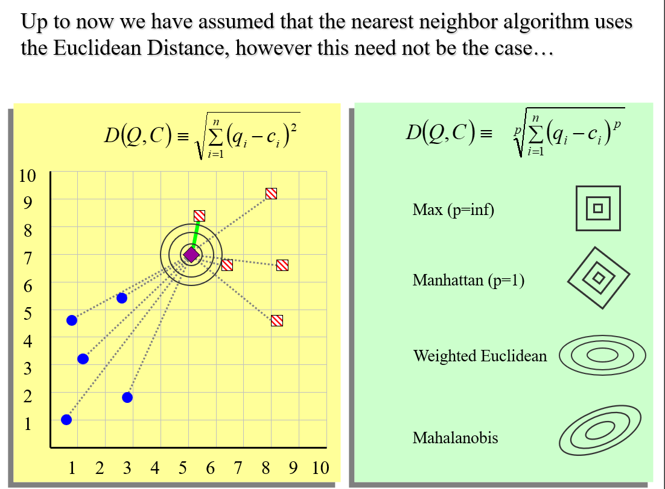

Slide 51
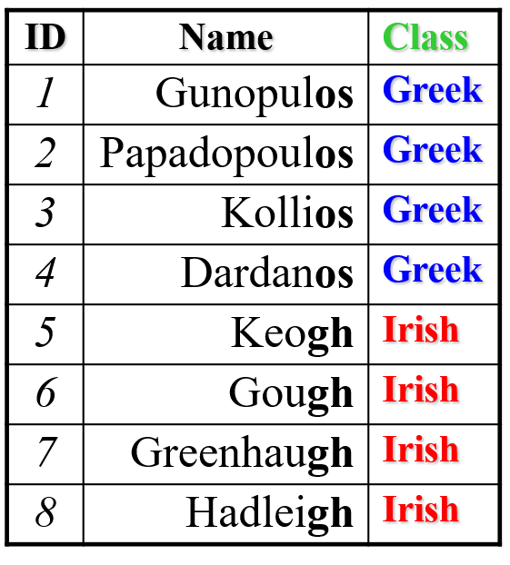
…In fact, we can use the nearest neighbor algorithm with any distance/similarity function
For example, is “Faloutsos” Greek or Irish? We Could compare the name “Faloutos” to a database of names using string edit distance…
edit_distance(Fatoutos, Keogh) = 8
edit_distance(Fatoutos, Gunopulos) = 6
Hopefully, the similarity of the name (particularly the suffix) to other Greek names would mean the nearest neighbor is also a Greek name.
Specialized distance measures exist for DNA strings, time series, images, graphs, videos, sets, fingerprints etc…

Slide 52
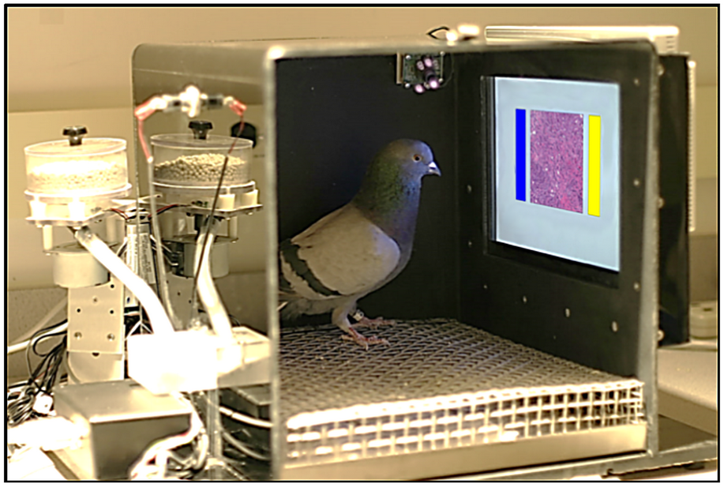
Pigeon Problems Revisited
Pigeons (Columba livia) as Trainable observers of Pathology and Radiology Breast Cancer Images

Slide 53
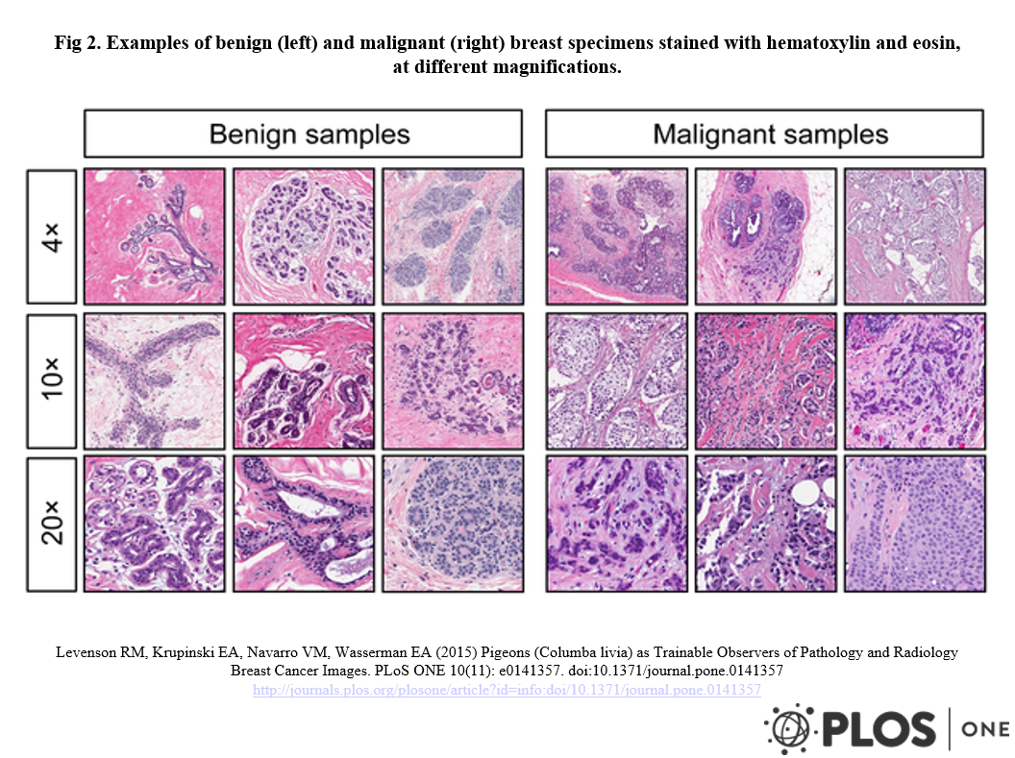

Slide 54
Dear SIR,
I am Mr. John Coleman and my sister is Miss Rose Colemen, we are the children of late Chief Paul Colemen from Sierra Leone. I am writing you in absolute confidence primarily to seek your assistance to transfer our cash of twenty one Million Dollars ($21,000.000.00) now in the custody of a private Security trust firm in Europe the money is in trunk boxes deposited and declared as family valuables by my late father as a matter of fact the company does not know the content as money, although my father made them to under stand that the boxes belongs to his foreign partner.
…

Slide 55
This mail is probably spam. The original message has been attached along with this report, so you can recognize or block similar unwanted mail in future. See http://spamassassin.org/tag/ for more details.
Content analysis details: (12.20 points, 5 required)
NIGERIAN_SUBJECT2 (1.4 points) Subject is indicative of a Nigerian spam
FROM_ENDS_IN_NUMS (0.7 points) From: ends in numbers
MIME_BOUND_MANY_HEX (2.9 points) Spam tool pattern in MIME boundary
URGENT_BIZ (2.7 points) BODY: Contains urgent matter
US_DOLLARS_3 (1.5 points) BODY: Nigerian scam key phrase ($NN,NNN,NNN.NN)
DEAR_SOMETHING (1.8 points) BODY: Contains 'Dear (something)'
BAYES_30 (1.6 points) BODY: Bayesian classifier says spam probability is 30 to 40%
[score: 0.3728]

Slide 56


